Slide 1
Crop Phenology Estimation
Sai Arvind(1602-19-737-092)
KVS Sriya(1602-19-737-115)

Slide 2
Abstract
The project aims to calculate Growing Degree Days for aiding Crop Phenology Estimation.
In this project we aim to calculate Surface Temperature from LandSat 8 for predicting GDD.
With the comparison of GDD for crops(Corn,SoyaBean) in different regions we expect to predict phenology of a crop in different climatic and environmental conditions.

Slide 3
Problem Statement
Crop Phenology is critical for agricultural management, estimation of crop yield, remote monitoring and advisory of crops using satellite imaging.
However, it has not been well studied and documented in the context of it’s application to crop identification, crop health, scheduling of irrigation.
Early detection of crop stages help in advance production estimation, predicting crop health.
With the comparison of GDD for crops in different regions we expect to predict phenology of a crop in different climatic and environmental conditions.

Slide 4
Literature Survey

Slide 6
Proposed Model
In this study we calculate Surface Temperature from LandSat 8 for predicting GDD and NDVI.
This study aims to assess the vegetation health and growing degree days (GDD) of Sangareddy, India using satellite imagery.
NDVI was extracted from time-series Landsat 8 data image data in Google Earth Engine (GEE) platform through Python API.
Normalized Difference Vegetation Index (NDVI) was calculated from Landsat 8 imagery for the years 2018-2021. These values were analyzed to identify any trends and changes in vegetation health over the years.
Predictive models were built to forecast NDVI using state of the art Prophet models.
FBProphet decomposes any time series data into trend, seasonality, event or holidays.

Slide 7
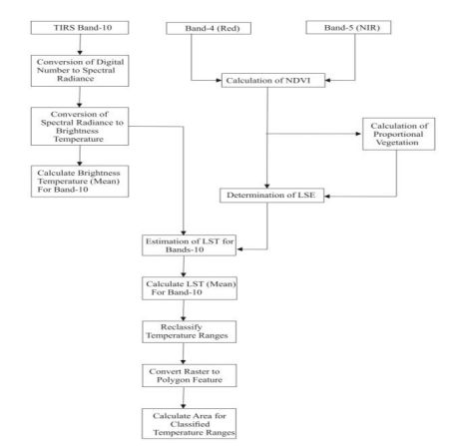
Flow Diagram

Slide 8
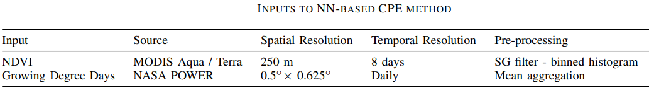
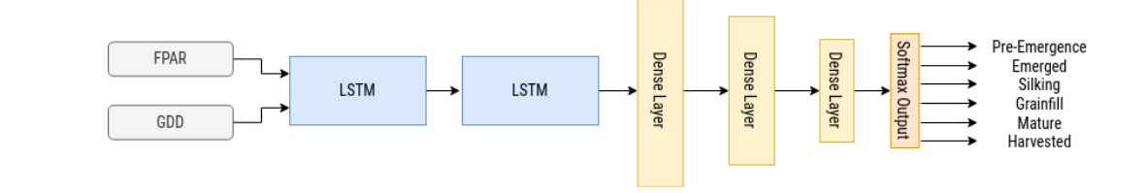
Existing Methodology

Slide 9
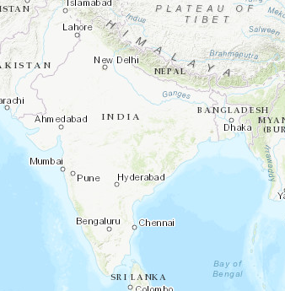
NASA POWER DATASET
Nasa power dataset provides solar and meteorological datasets from NASA research for support of renewable energy efficiency and agricultural needs
https://power.larc.nasa.gov/data-access-viewer/

Slide 10
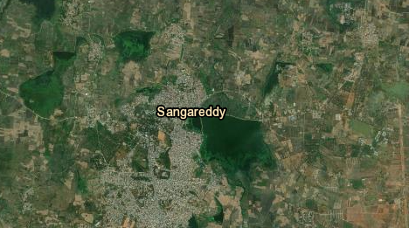
LANDSAT 8 DATASET
Landsat-8 is one of the National Aeronautics and Space Administration (NASA) Landsat series. The Landsat-8 data is accessible in United States Geological Survey (USGS). The website Earth Explorer is free of cost. The images of entire earth are taken by Landsat-8 satellite after every 16 days. In the current study, to estimate brightness temperature the TIR bands (10) were used
https://earthexplorer.usgs.gov/

Slide 11
Sample Dataset -Sangareddy

Slide 12
Evaluation Metrics

Slide 13
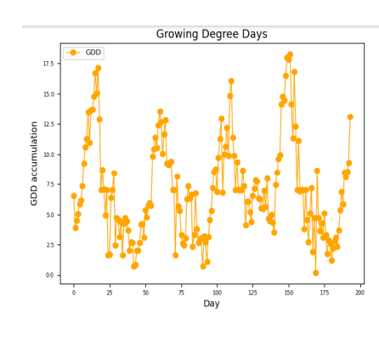
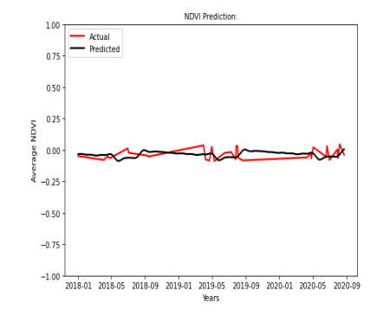
Results

Slide 14
Analysis

Slide 15
Conclusion and Future Scope
The proposed technique is deployed in moderately large area in India and we found highly consistent detection of the phenology points.
Considering the fact that the time-interval between two acquired timestamps is 5 days or more, this is quite a remarkable achievement for a medium temporal resolution satellite data.
The major challenge faced while deploying this to the entire region is when the signal dropped due to longer period of cloudy days.
In these cases, it is unlikely to generate the real crop signature unless we can estimate the missing data by augmenting it with spatial features

Slide 16
THANK YOU

